Slide 1

CIS 303 Capstone Project
Presented by Jerry C

Slide 2
Table of contents
01
Project Outline
02
SDLC Implementation
03
Project Management: Jira
04
Design Algorithm & Demo

Slide 3
Project Outline
Portfolio Website
Home
About
Projects
Header
Section Content
Project Display
Main Content
Design and Layout
Interactivity and Design
Design Elements
Accessibility and Navigation

Slide 4
SDLC Implementation
SDLC
Software Development Life Cycle
Maintenance
M
P
Planning
Regular Updates, Feedback Incorporation
Objective Definition and feasibility study
Testing
T
A
Analysis
User Experience and Functionality Testing
Requirement Gathering and resource allocation
Implementation
I
D
Design
Develop the website using JavaScript, HTML, CSS
Architecture and UI/UX Design

Slide 5
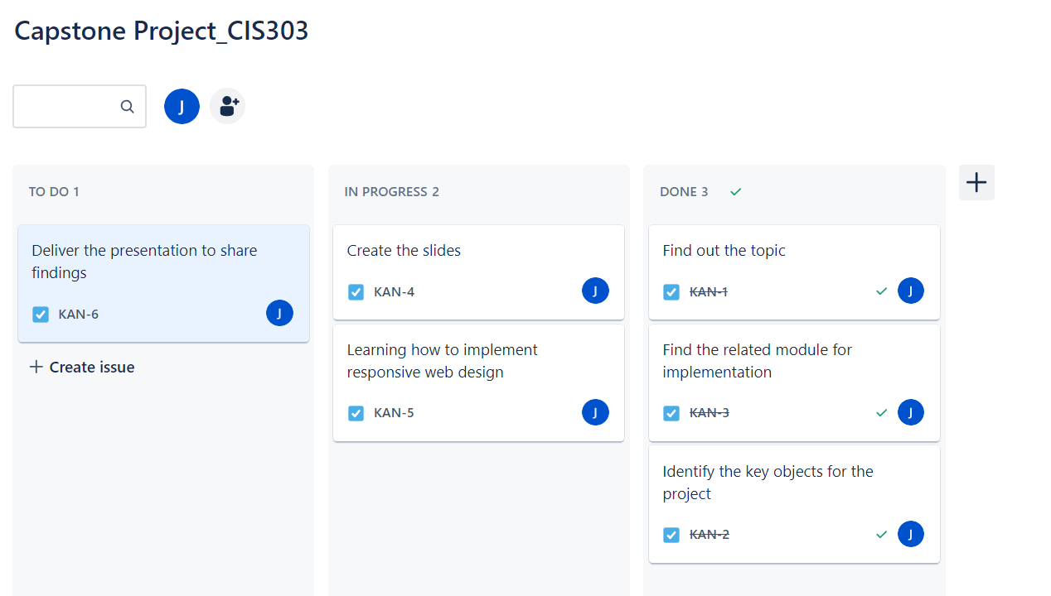
Project Management: Jira

Slide 6
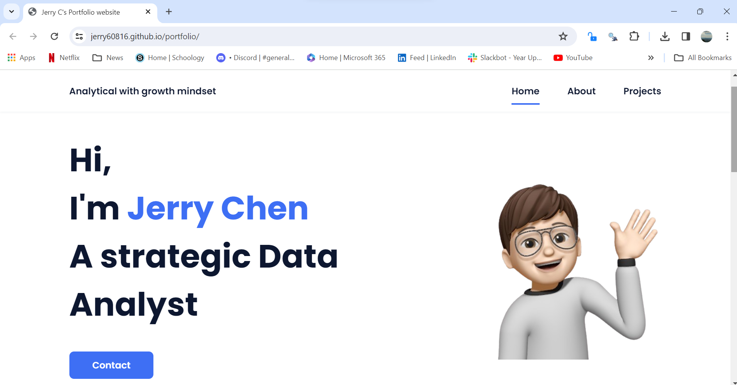
Design Algorithm & Demo

Slide 7
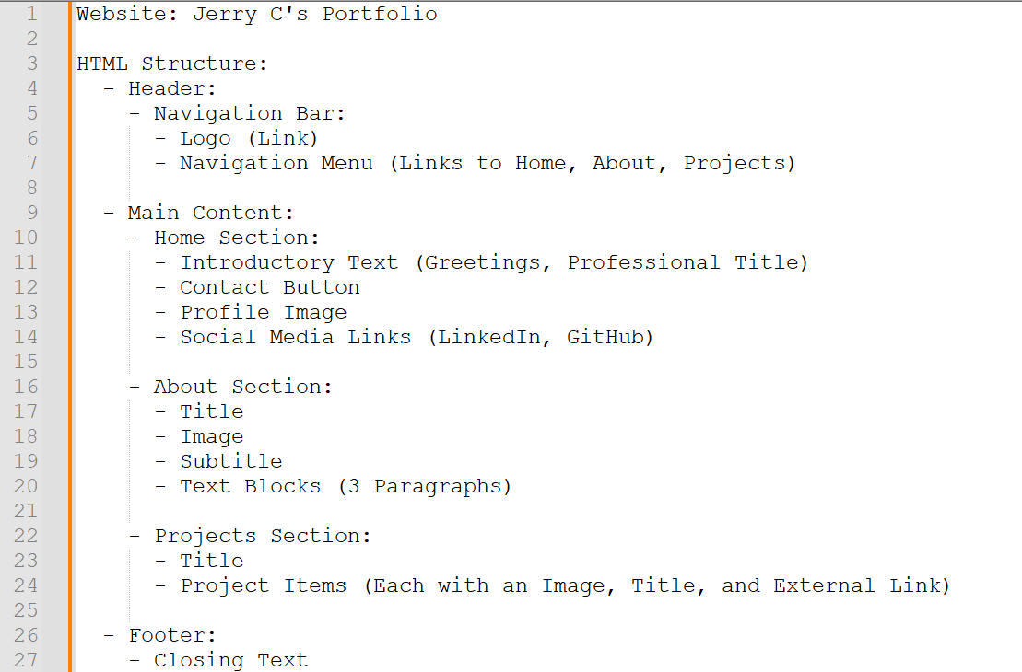
Design Algorithm

Slide 8
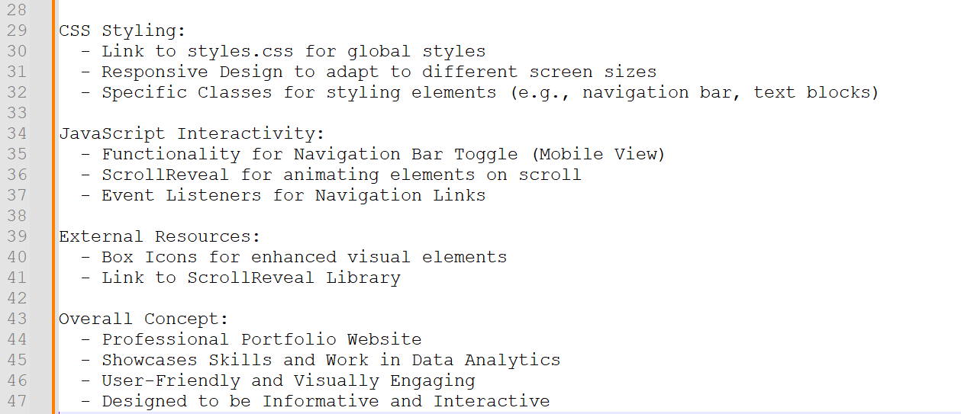
Design Algorithm

Slide 10
Thank you :)

